Slide 1
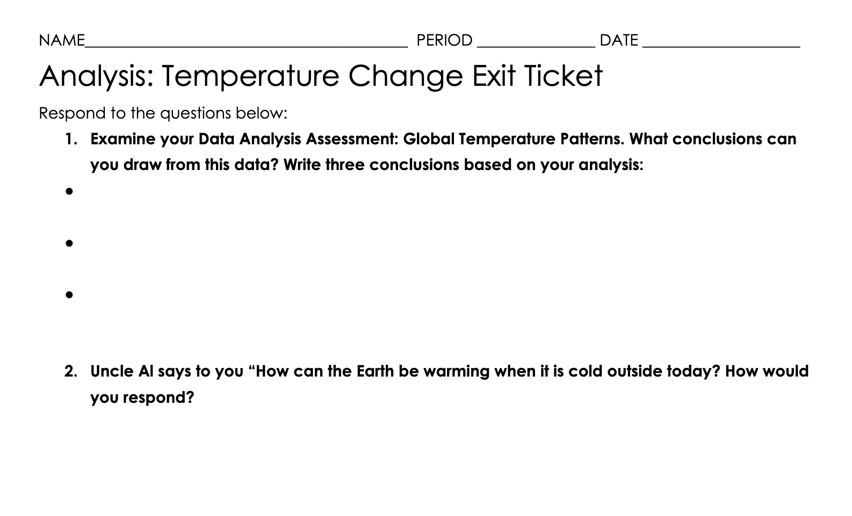
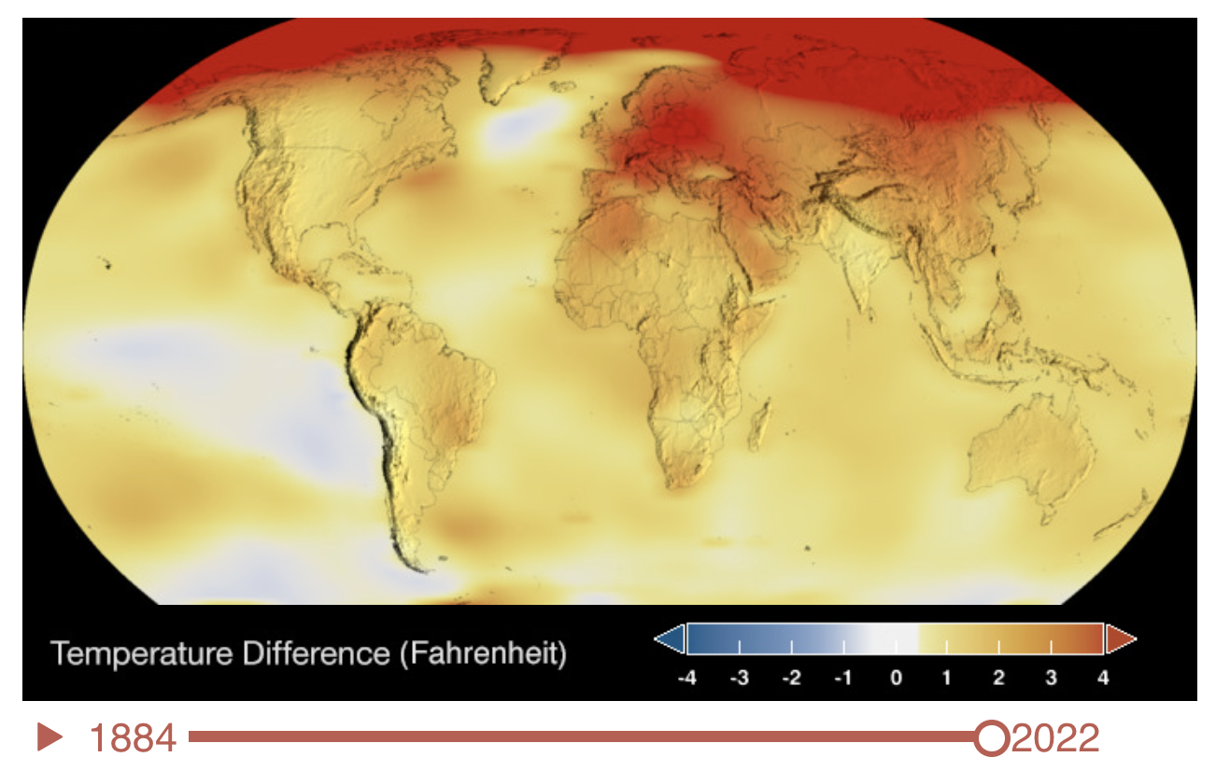
Wrap UP:
Welcome to class. Find your assigned seat. Collect your INB, pencil, salmon file and orange exit ticket.
Collect your Salmon File and located your assessment work: Data Analysis. Global Temperature Patterns.
Complete the ORANGE exit ticket.
Get a stamp. Leave your stamped exit ticket in your Salmon File in your period INBOX.

Slide 2
Warm Up:
On the white board with your table group:
Show a model of how global temperature change patterns impact the water cycle.
Remember the water cycle processes, including evaporation, condensation, precipitation, and melting describe phase changes of water molecules (H₂O).
Show how these processes are impacted with changes in global surface temperature.
Draw a diagram model on the white board to share your thinking.

Slide 3
Climate Change Lesson 4
Drought and its Impact.

Slide 4
In the Lesson you will:
Read and mark the text to define droughts.
Watch videos and identify causes of drought and water scarcity.
Share and apply your understanding to questions about droughts.
At the end of the lesson you will be able to:
Define droughts and causes of drought and water scarcity.

Slide 5
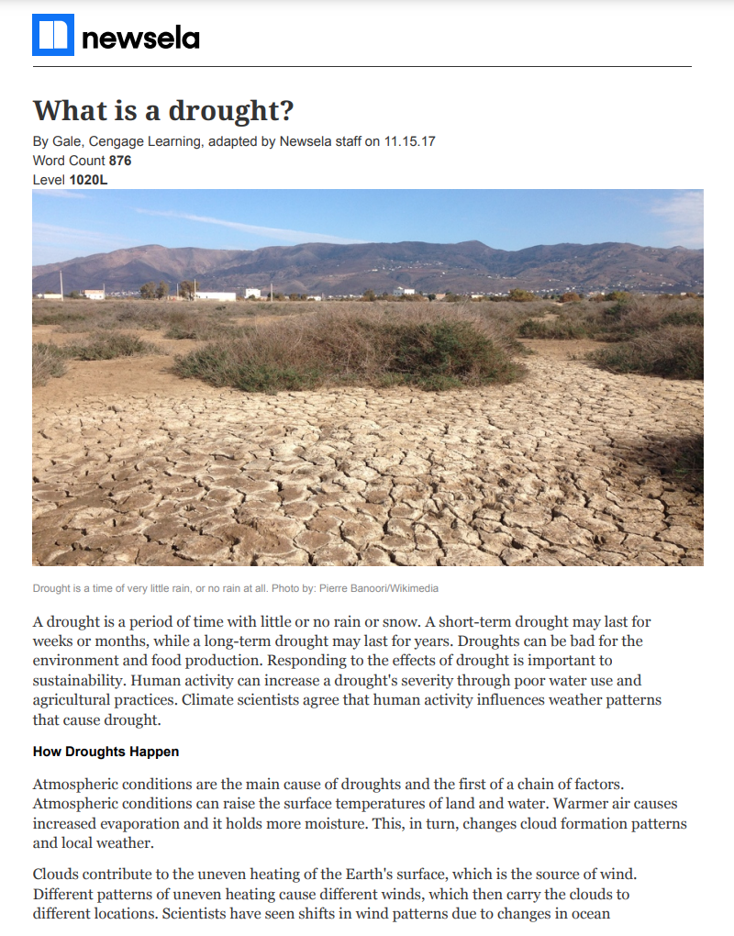
What is drought?
Collect the article and highlighter.
Today you will read and mark the text.
Let's read together to
Highlight ideas that explain droughts and how they happen.
Identify what ideas about drought that surprise you. * Star ideas that surprise you.
Create a pocket for your reading. Title: What is drought?

Slide 6
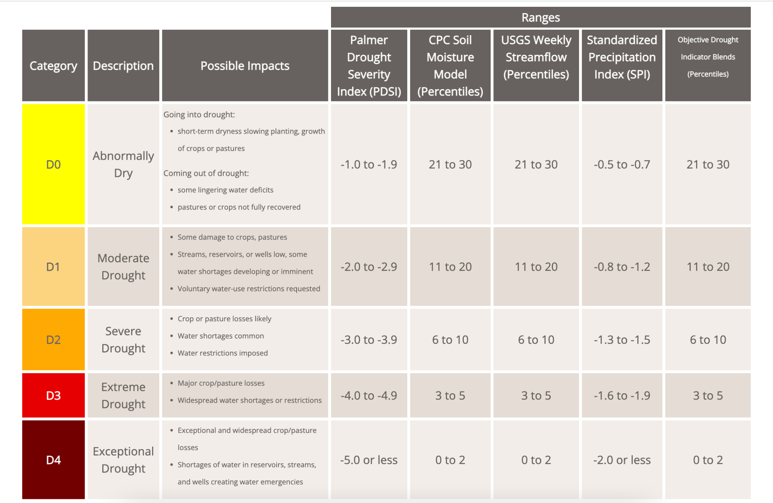
What is drought?
Lets review and color the different drought categories.
Glue the drought categories table in your INB.
Color code each category as shown.
Add the following notes under the title:
Definition: A drought is a period of drier than normal conditions that results in water-related problems.
Notes on drought:
Different indicators tell us how bad drought is in a given region. Indicators include:
How much moisture is in the soil.
How much water runs in the streams.
The amount of precipitation compared to the surface temperature.
A drought happens when there is less precipitation in an area then normal.

Slide 7
What is drought?
Welcome to class. Find your assigned seat. Collect your INB, pencil, yellow, orange, red, brown color pencils.
Complete the following in your INB:
Definition: A drought is a period of drier than normal conditions that results in water-related problems.
Notes on drought:
Different indicators tell us how bad drought is in a given region. Indicators include:
How much moisture is in the soil.
How much water runs in the streams.
The amount of precipitation compared to the surface temperature.
A drought happens when there is less precipitation in an area then normal.

Slide 8
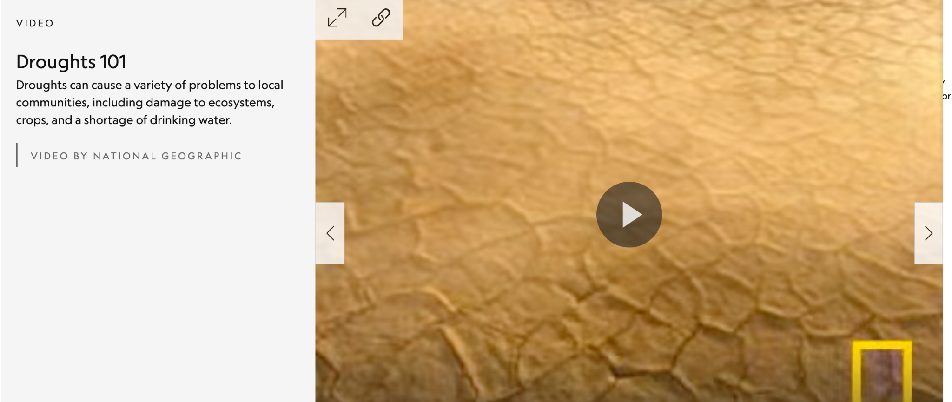
Review
What is a drought?
How does a drought occur?

Slide 9
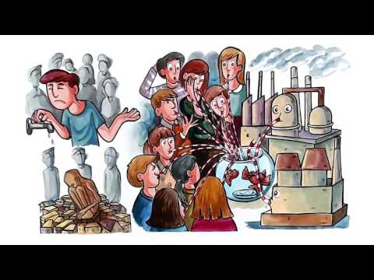
What causes drought or water scarcity:
Water scarcity occurs when people don't have enough fresh water to meet demand. What ideas did you hear that contribute to water scarcity?
Notes:
https://www.youtube.com/watch?time_continue=1&v=JyzvcrZIuf0&feature=emb_logo

Slide 10
Review: Use your INB notes to help!
Get into a group and pick a white board to record your thinking. No more than 4 in a group please.
Respond to the following questions on your board (no need to write the questions down):
What is drought? Would a desert be a drought? Why/why not?
How do we measure a drought?
How long can a drought last?
List two or three factors that cause droughts.
Task Manager: Keep everyone on topic and on task. | Recorder: Write/sketch responses neatly on the whiteboard
Facilitator: Make sure everyone contributes | Resource Manager: collect marker(s), make sure they are used appropriately, return in good order, wipe down boards at then of the class.

Slide 11
In the Lesson you will:
Explore patterns of drought in the West Region of the United States over time.
At the end of the lesson you will be able to:
Complete an assessment to describe patterns of drought over my lifetime in the West.
ASSESSMENT: I can analyze and interpret data to explain a drought patterns.
Standard: I can analyze and interpret data to explain a scientific phenomenon.

Slide 12
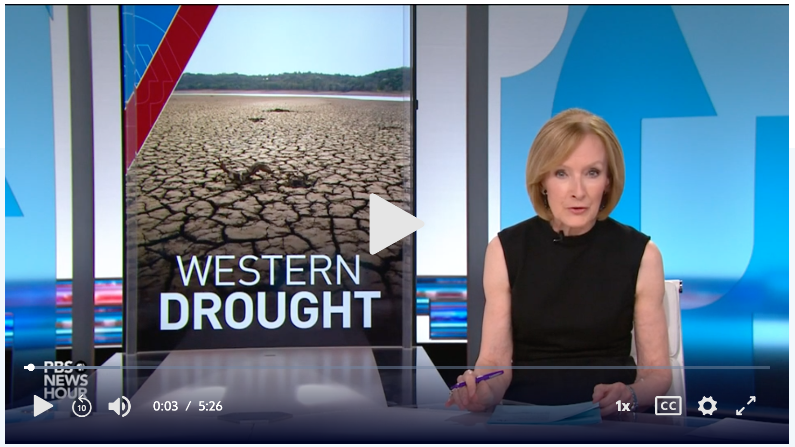
Drought in the Western United States:
What ideas to you hear related to pattern of drought?
What ideas do you hear related to causes of drought?
What ideas do you hear related to impact of droughts?
Notes:
https://www.pbs.org/newshour/science/whats-causing-the-drought-in-the-west-and-why-its-so-bad

Slide 13
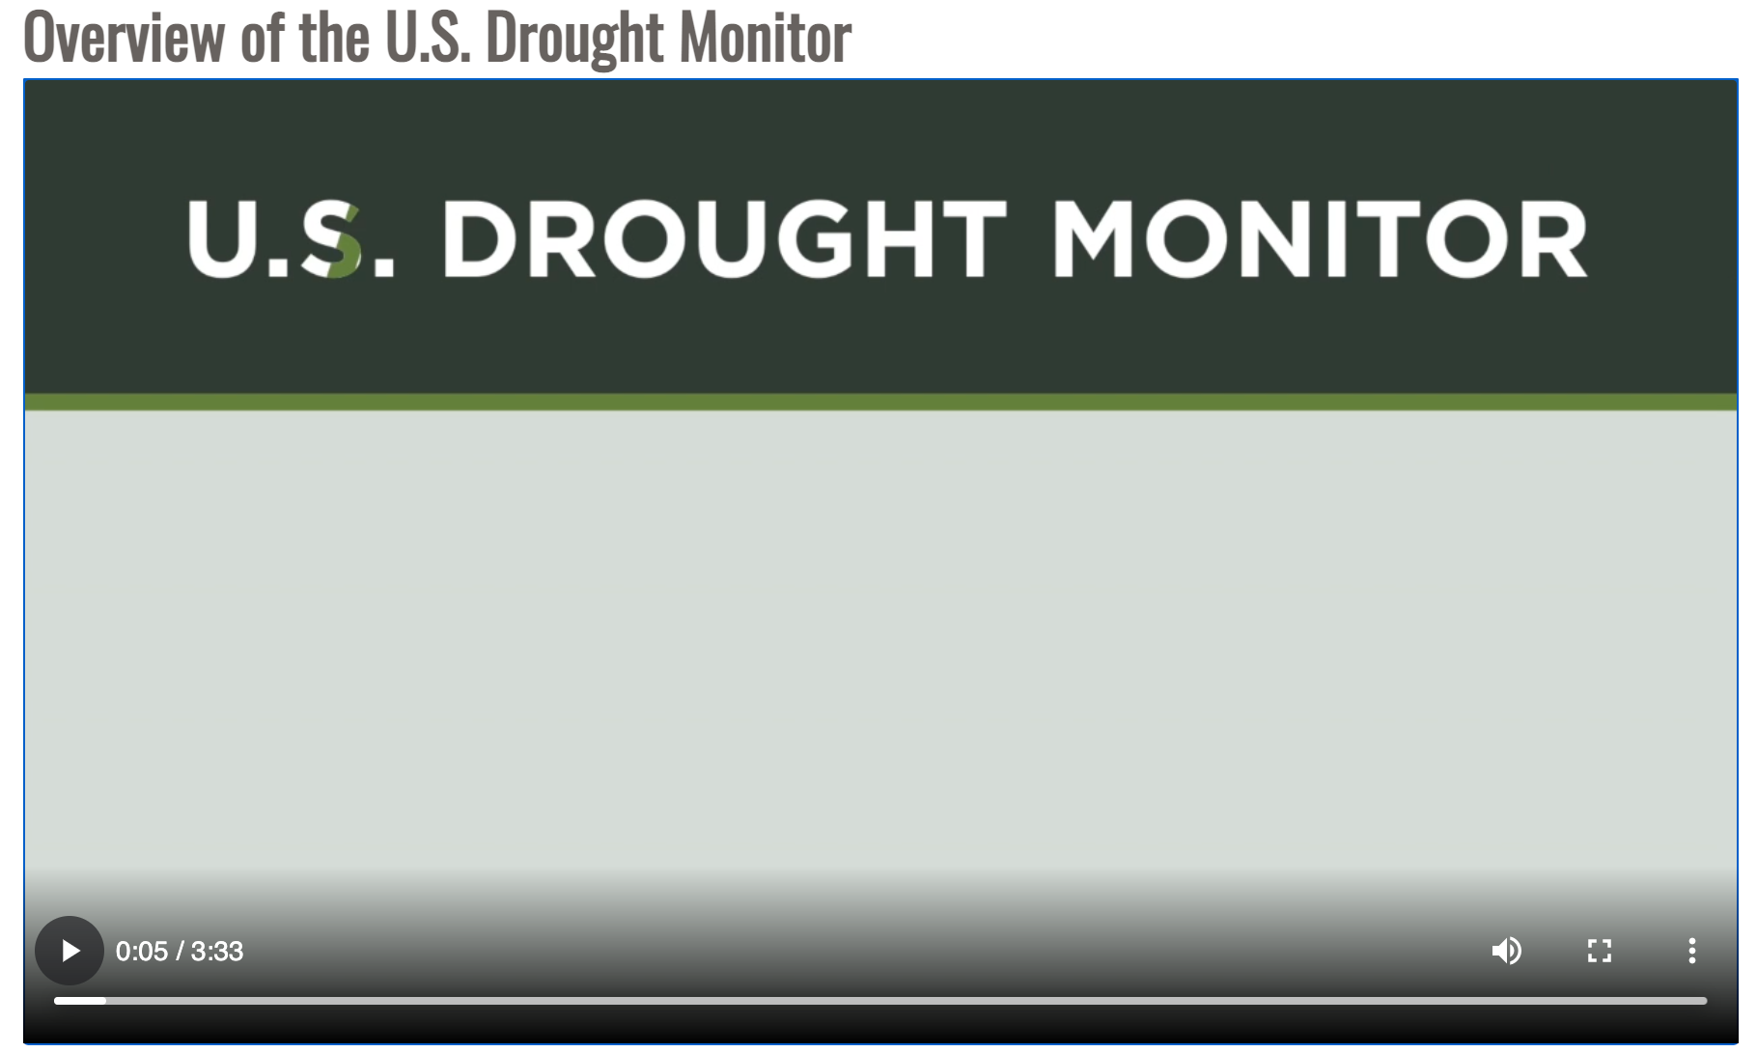
How we monitor drought to show patterns?
What data can we use to describe patterns of drought?

Slide 14
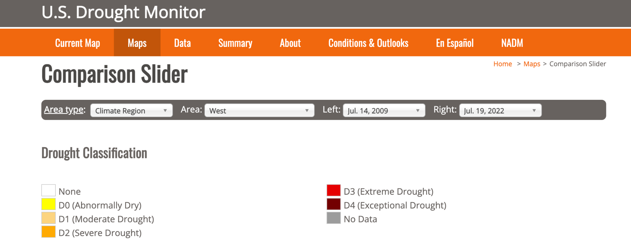
Analyzing the drought patterns?
We will use the Comparison Slider on the US Drought Monitor map to compare different time periods of drought pattern. Let’s practice.

Slide 15
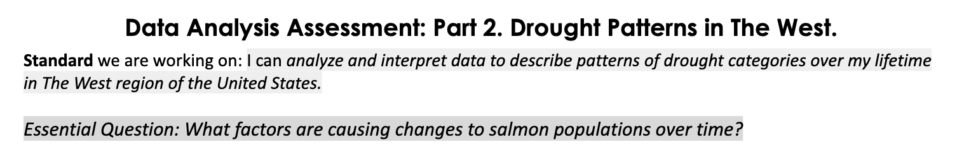
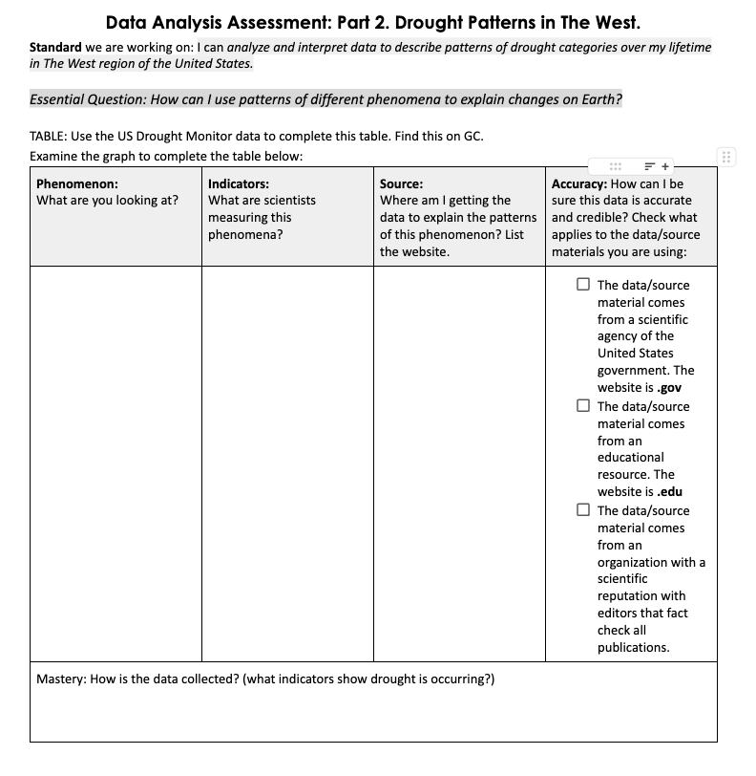
Assessment: Data Analysis and Interpretation
Step 1: Use the Drought Monitor Map website to complete the table. Use the Checklist to make sure you are meeting the PROFICIENCY requirements for this assessment.

Slide 16
Assessment: Creating the MAPS:
Step 2: You will use the drought monitor Comparison Slider on GC to describe the patterns of drought over your lifetime. You will look at TWO different snapshots of time as follows:
Map A: Drought Patterns in The West on the Day I was Born (or closest date available on the data set).
Map B: Drought Patterns in The West on My Last Birthday (or closest date available on the data set). Or the date of your birthday in 2021 when the West experiences worst drought.
You will create 2 maps showing the drought data as color categories of drought. Each map will show the pattern of drought in The West for each of the four dates (day, month and year).
You will use a map template to recreate the patterns of drought with colors. Create a key. Remember to title each map. Use the checklist to meet PROFICIENCY.
You will complete the Data Analysis Assessment: Part 2. Drought Patterns in The West using the checklist to meet PROFICIENCY.

Slide 17
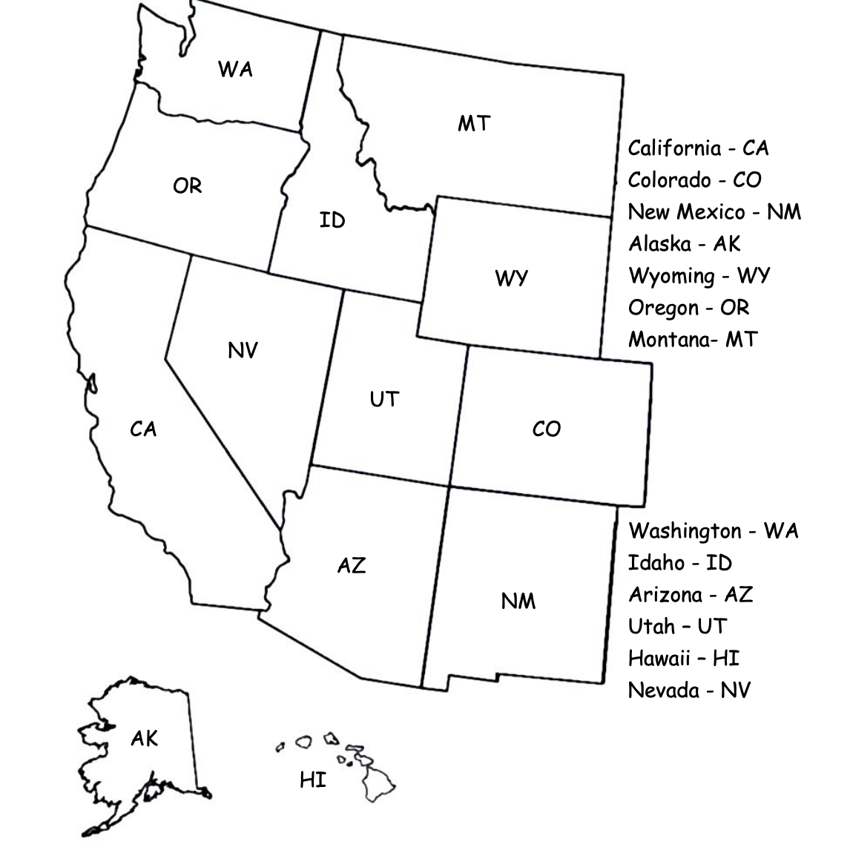
Know the States:
Step 2: Color code each State in the Western Region on both maps for the day you were born and the day of your last birthday. This is about a 12-13 year difference. We are not looking at Alaska and Hawaii

Slide 18
Assessment: Analysis Questions
Step 3: Complete the Analysis Questions in your Assessment package. Use the checklist to meet PROFICIENCY. How have the patterns of drought changed from the day you were born to your last birthday?
Q1: When I was born, add date the drought pattern showed….
Describe areas where there was no drought. For example: In Montana, Idaho, and Wyoming and most of Colorado there was no drought in May 2010.
Describe areas that were were abnormally dry. For example: Part of central California and southern Oregon experienced abnormally dry conditions.
Describe areas where there was moderate and/or severe drought. For example: Parts of northern California and southern Oregon experienced severe drought.
On my 12/13 birthday, drought patterns changed across The West.
Describe the pattern of extreme and exceptional drought. Did everywhere experience some sort of drought? Are there places with no drought?
Q2: How is the drought pattern different at six month intervals? For Example (if I was born in May I would explore the pattern in May and Nov (6 months later) in the same year:
The pattern of drought between May (my birthday month) and Nov (my half birthday) in 2023 was……..(you need to observe the pattern on the comparison slider and compare these two time periods). The pattern of drought between May (my day of birth) and Nov (when I was six months old) was…….Why would these months show different patterns of drought? Explain.

Slide 19
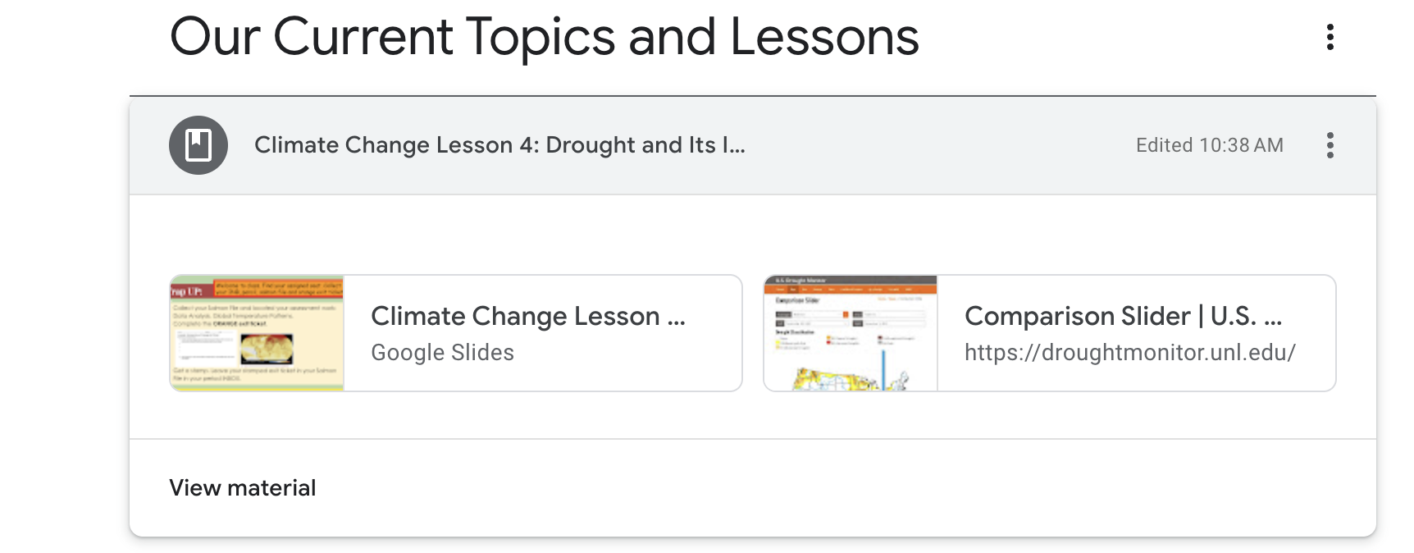
Do Now:
Collect your Drought Patterns Assessment from your period INBOX
Make sure you have the pencils you need for your map.
Open your chromebook and find the Drought Monitor Comparison Slider in the GC.
Complete your maps (Map A: When you were born. Map B: On your birthday in 2021 (mega drought) or 2021 or 2023). Complete the written analysis
Thursday you will showcase ALL of the work in your Salmon File.

Slide 20
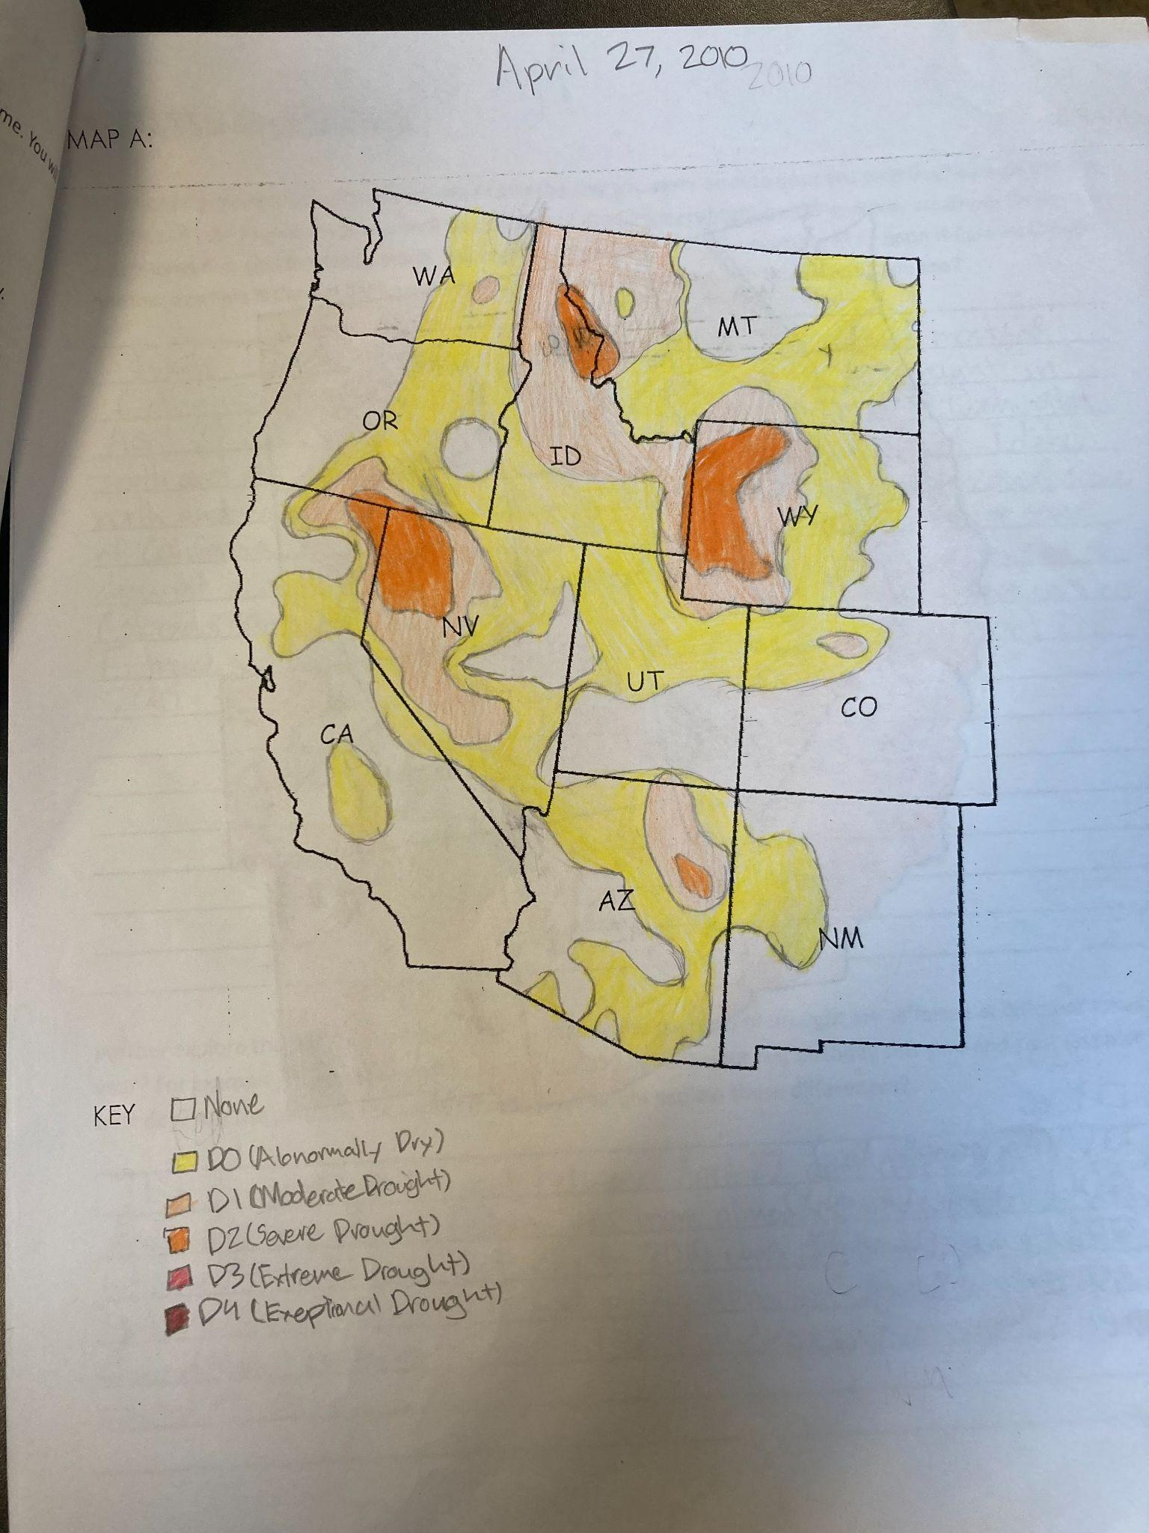
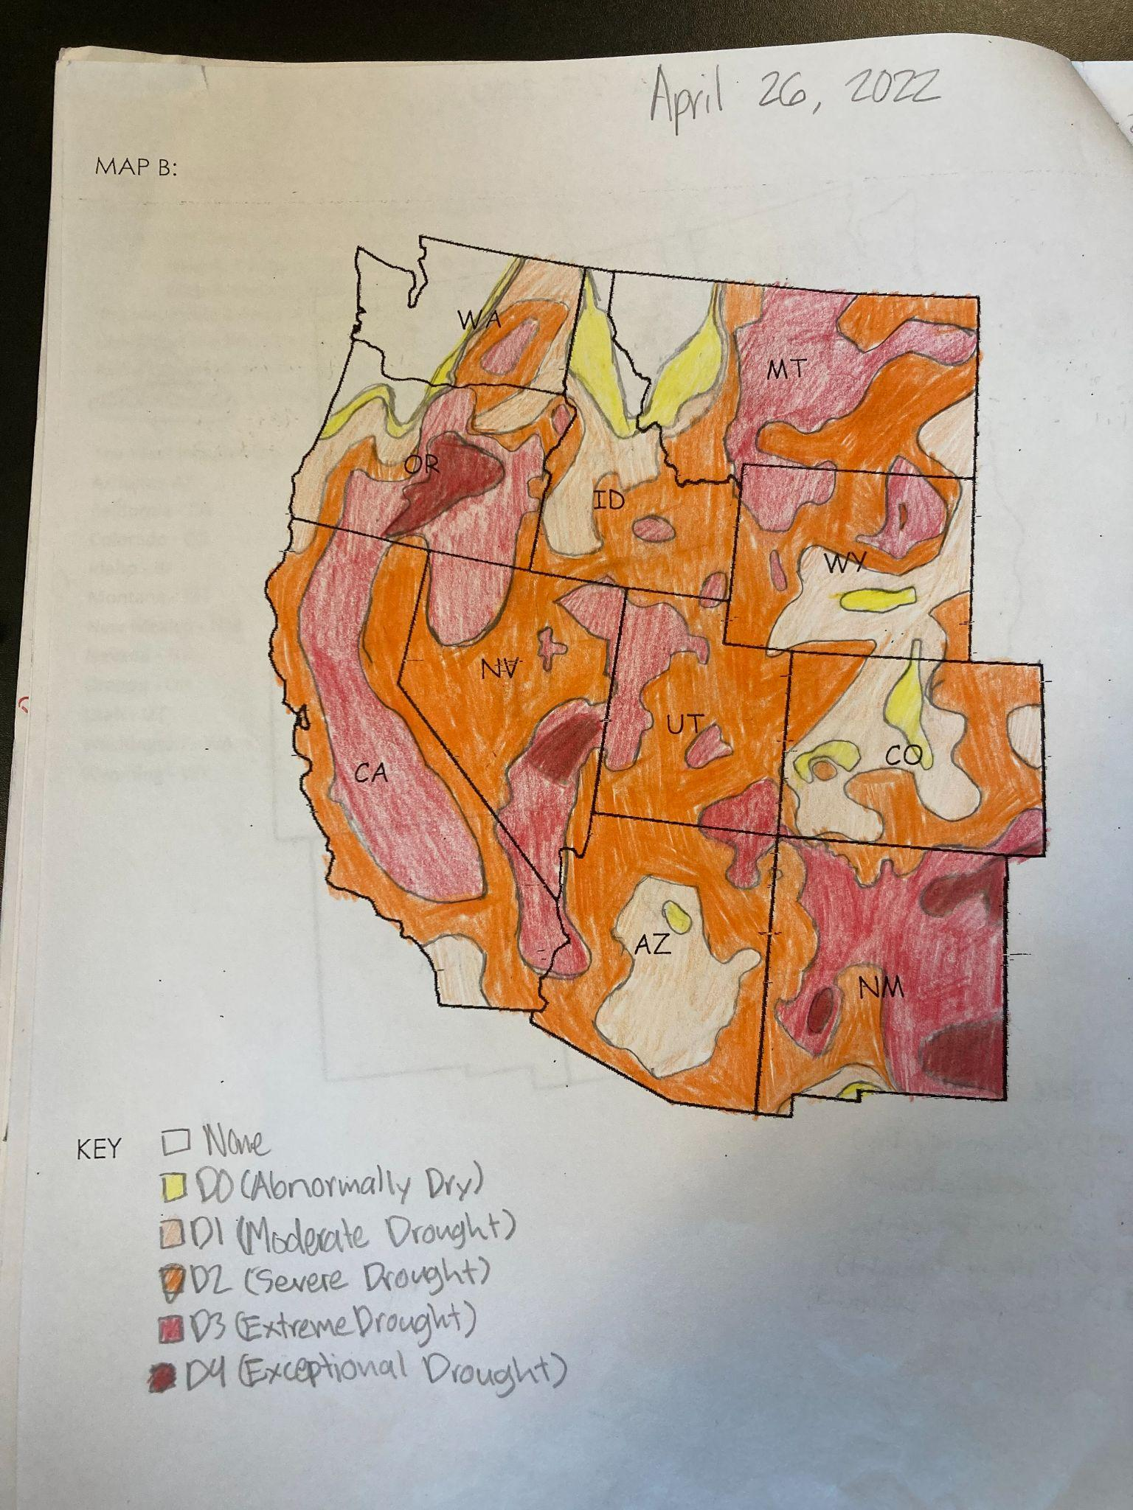
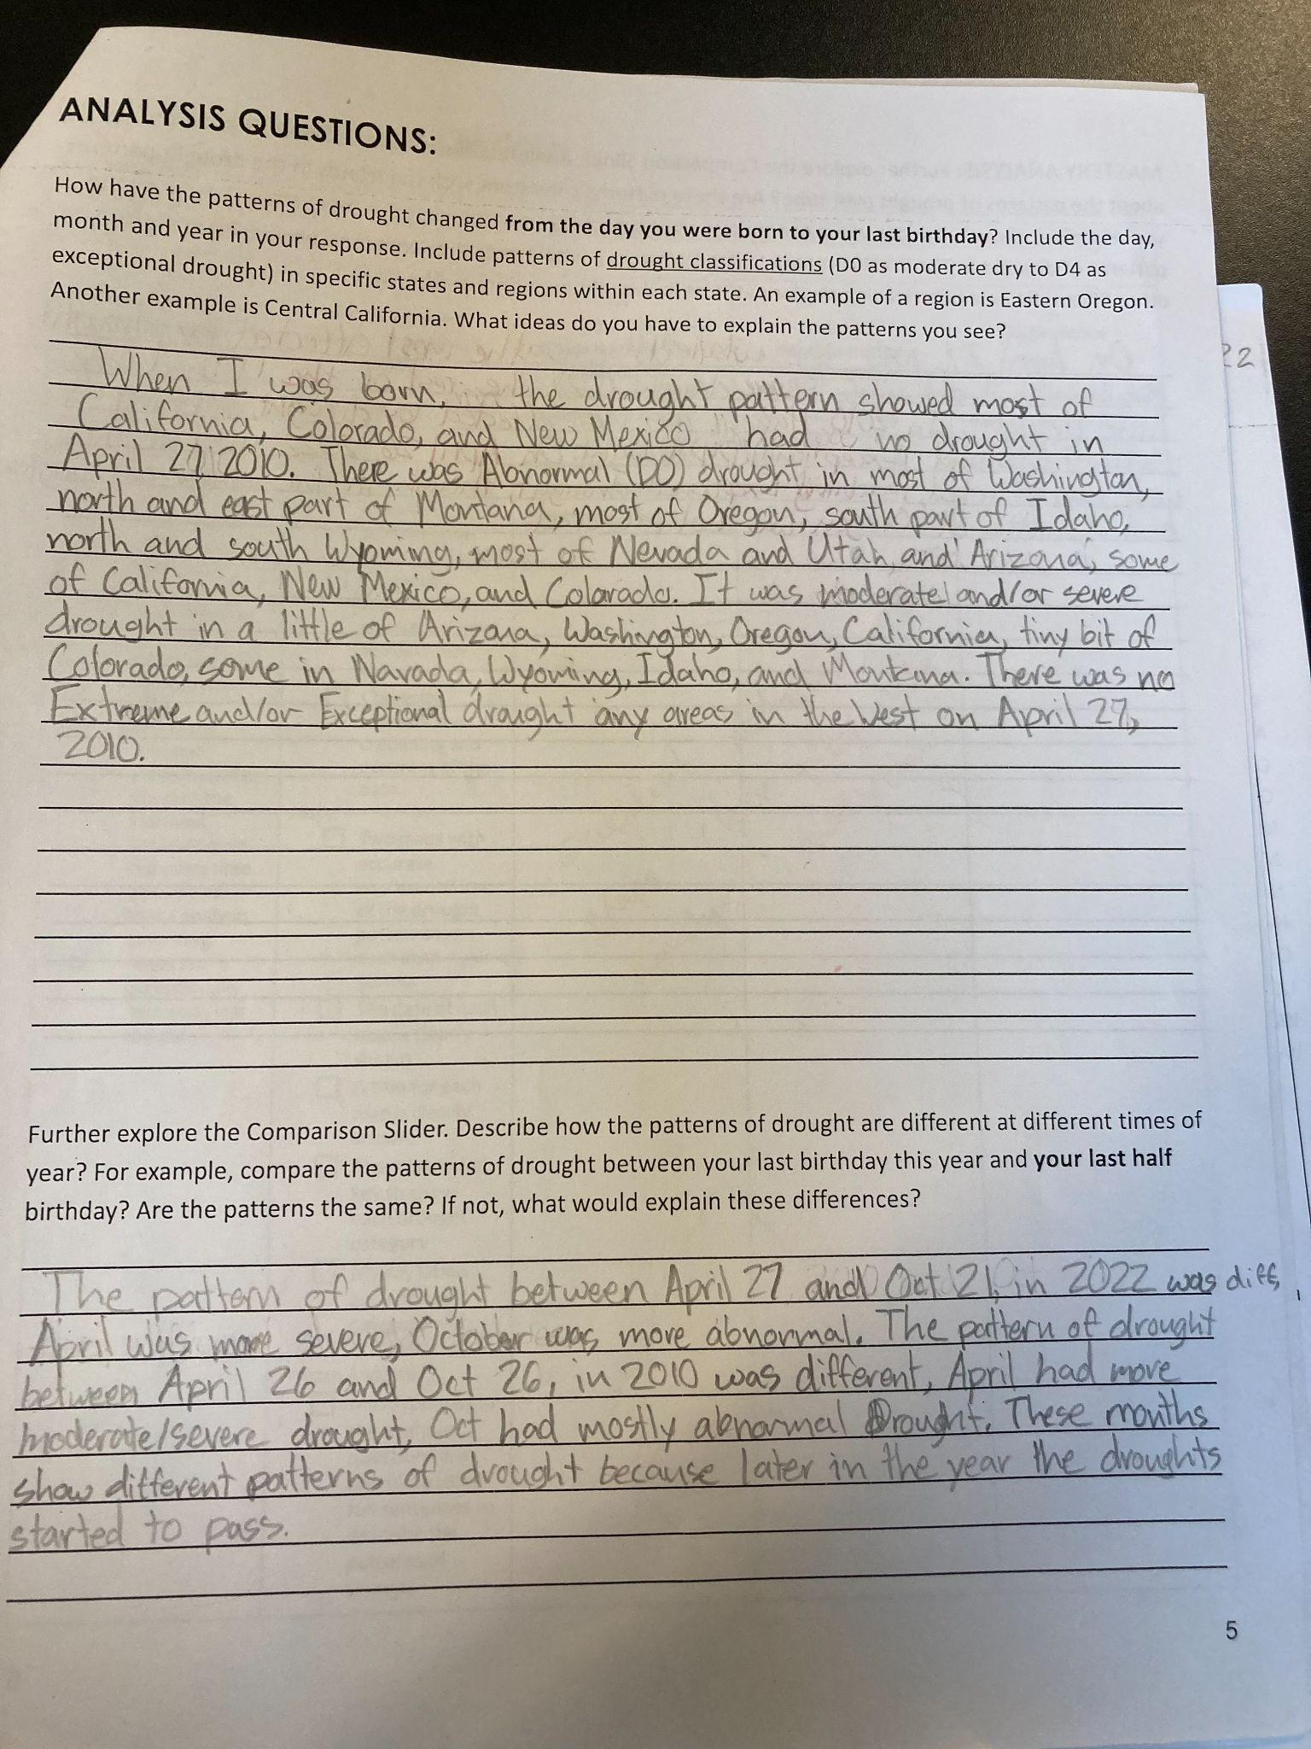
Assessment: Example Work
Add the title!
Add the title!
Notice the date. Do you see a key? A title?
Notice the date. Do you see a key?A title?
Analysis Responses: Full descriptions of the patterns.

Slide 21
Warm Up: Drought Categories
On the white board:
List the categories of drought and the description.
Identify one impact for each category of drought.

Slide 22
Warm Up:
Look at your notes to complete the definition:
Definition: A drought is a period of drier than normal conditions that results in water-related problems.
What do we measure to figure out if the landscape is experiencing drought? Identify the three indicators (hint: look at your notes in you INB).

Slide 23
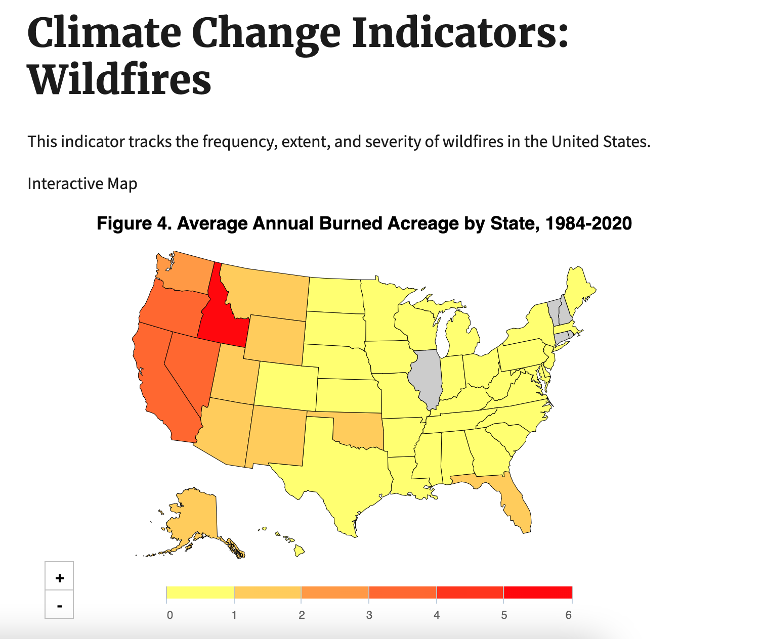
Extension
Resources:
https://multimedia.journalism.berkeley.edu/blog/fires-data-visualization/
https://www.epa.gov/climate-indicators/climate-change-indicators-wildfires
https://www.buzzfeednews.com/article/peteraldhous/california-fires-record-burn-fire-apocalypse
https://www.nytimes.com/interactive/2022/us/fire-tracker-maps.html
https://newsela.com/read/specials-pearson-indigenous-fire-management/id/2001013064/
https://education.nationalgeographic.org/resource/extreme-weather-droughts/
What are the patterns of wildfires in The West?

